Slide 1
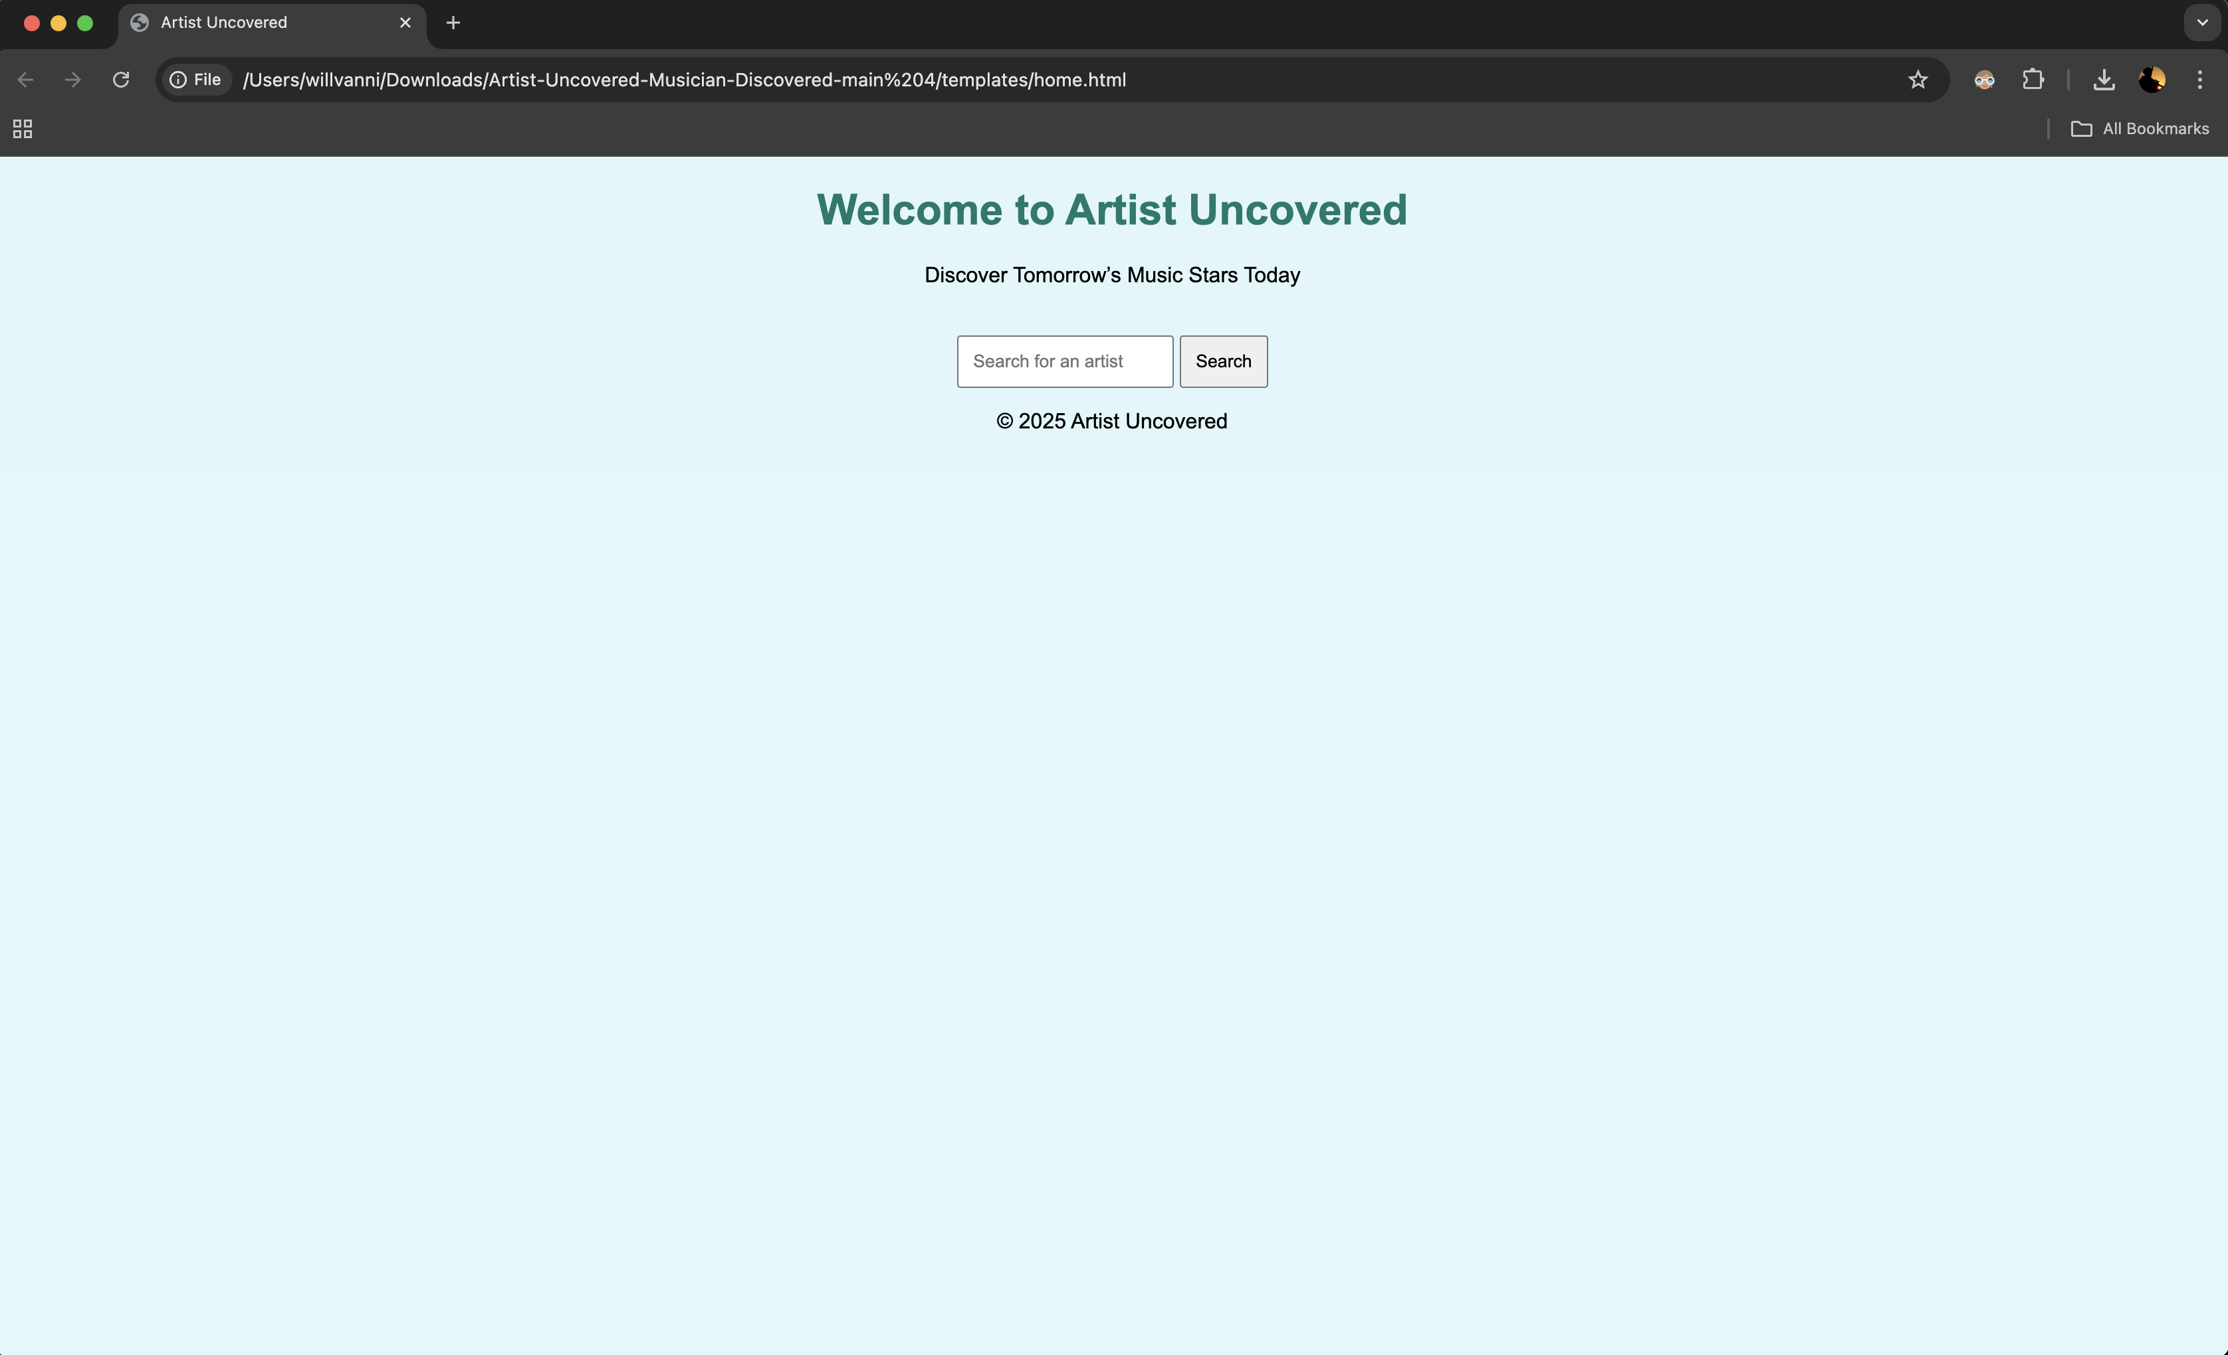


Artist Uncovered, Musician Discovered
https://github.com/ksu-is/Artist-Uncovered-Musician-Discovered
Project by
Will Bates Skelly
Discover Tomorrow’s Music Stars Today

